Slide 1
Analysis of LTI System using Fourier Transform

Slide 2
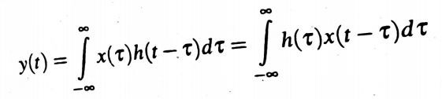

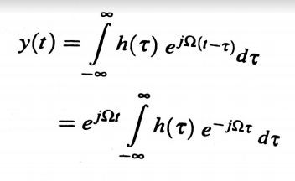
Let us consider an LTI Continuous –time system with impulse response h(t).If the input to the system is x(t),then the output y(t) can be obtained using convolution integral.
If the input is a complex exponential signal
then the output

Slide 3


We know that
Therefore
In the above equation the signal e^{jΏt} is known as eigen function of the system and H(jΏ) is its eigen value.
Now we find that the output y(t) is a signal obtained by multiplying the input e^{jΏt} with H(jΏ)
H(jΏ) is the Fourier Transform of impulse response and also known as the frequency response of the system.In General

Slide 4
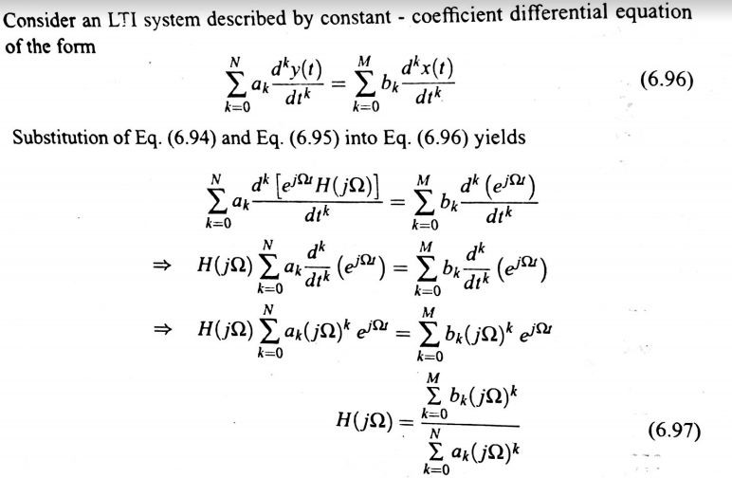

Slide 5
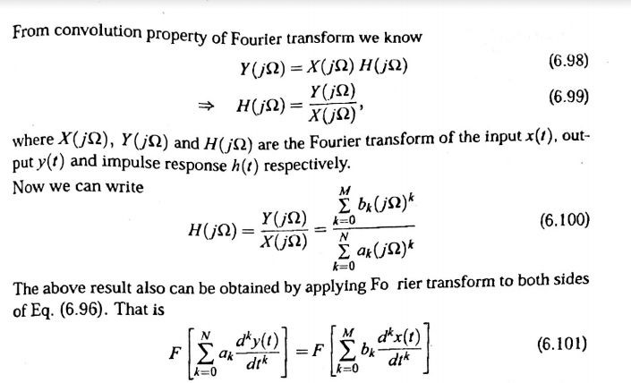

Slide 6
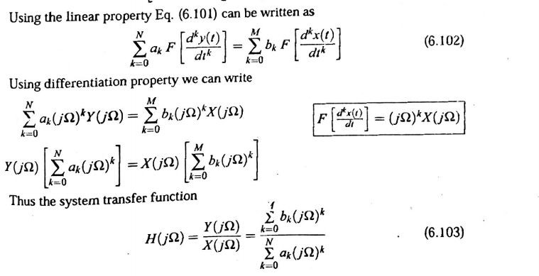

Slide 7
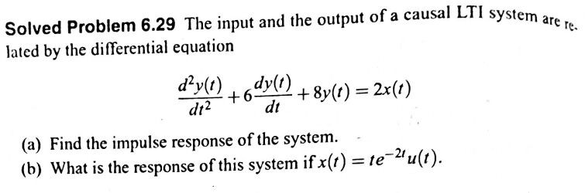
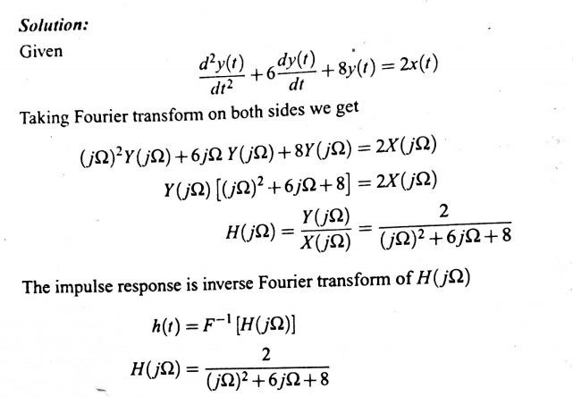

Slide 8
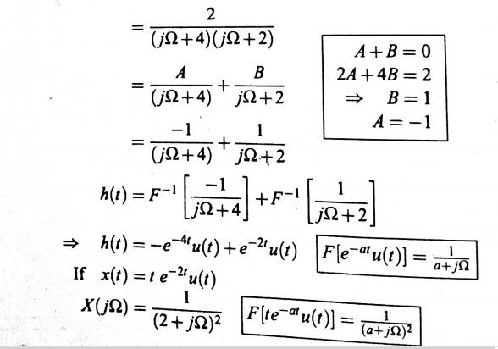

Slide 9
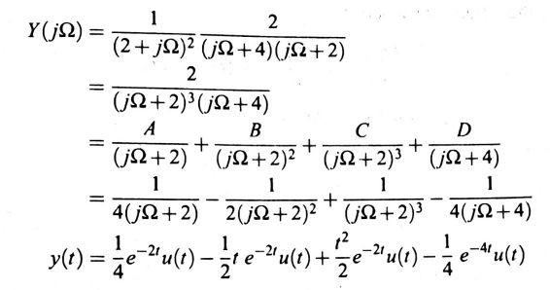

Slide 10
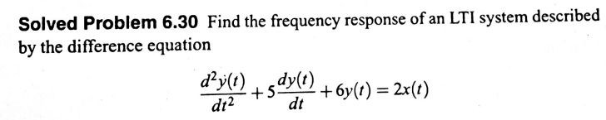
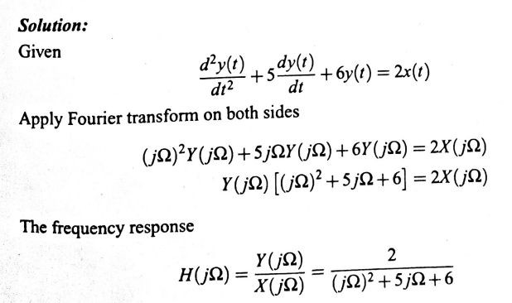

Slide 11
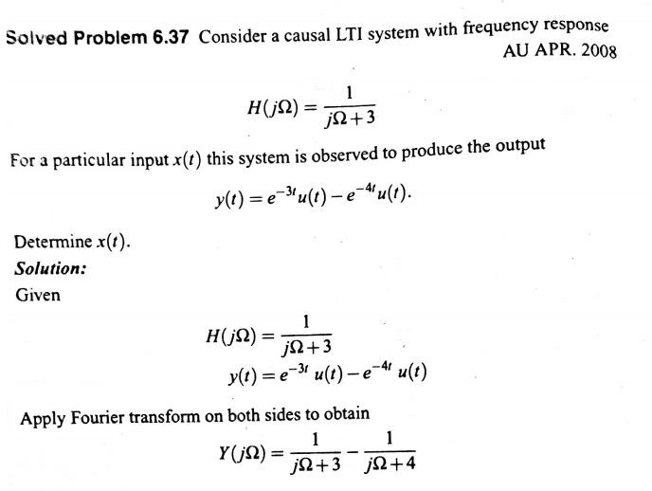

Slide 12
